Slide 1
Interns Project Presentation
16 June 2025 Monday
Team:
Aakarshit Srivastava Bhaskar Banerjee
Manager:
Abhijit Thorat

Slide 2
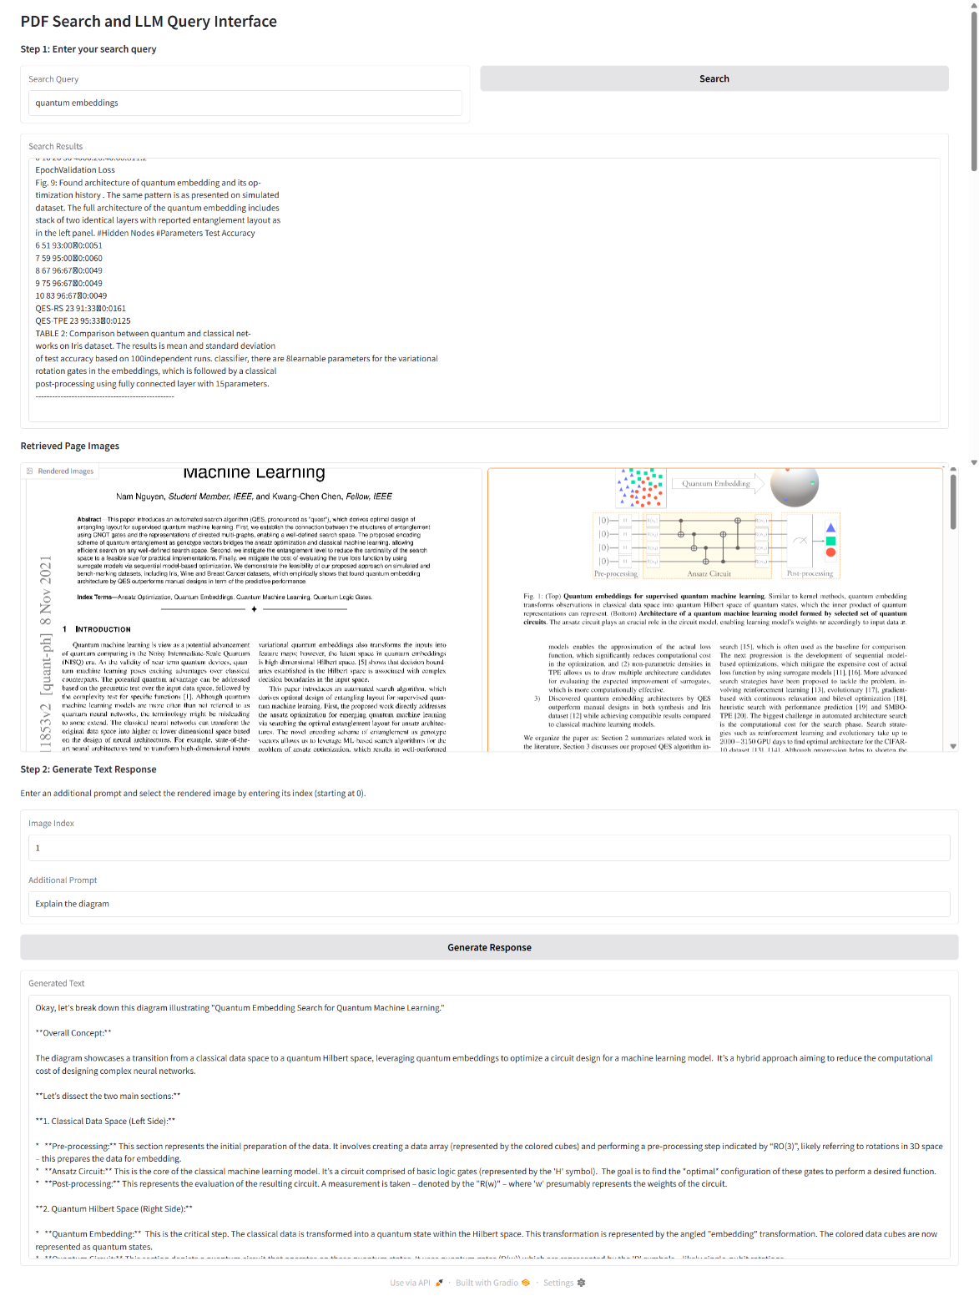
Hybrid RAG Multi‑Modal
Goal: Unified retrieval & generation over text + images
Architecture:
Sentence‑Transformer text encoder
Fusion retriever
LLM generation
Key Tech: PyTorch, Hugging Face, nomic AI
Outcome: +12 % accuracy on mixed‑media QA; live demo answering image queries

Slide 3
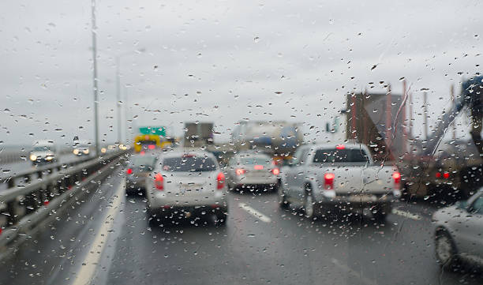
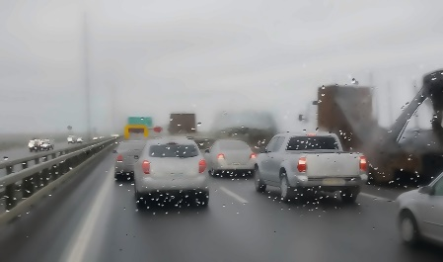
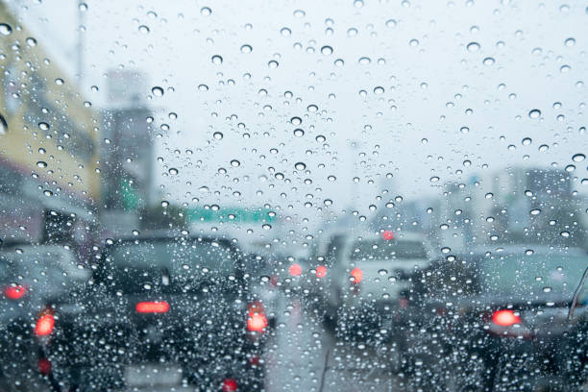
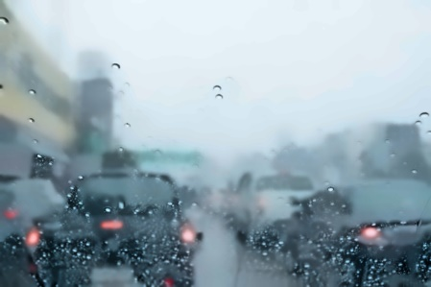
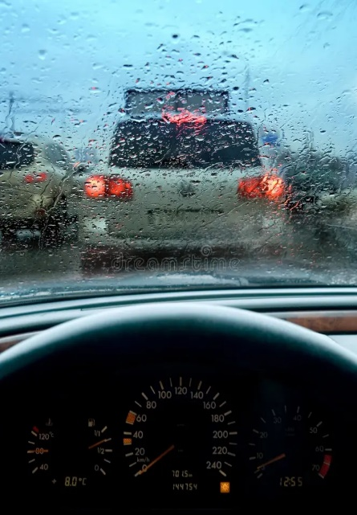
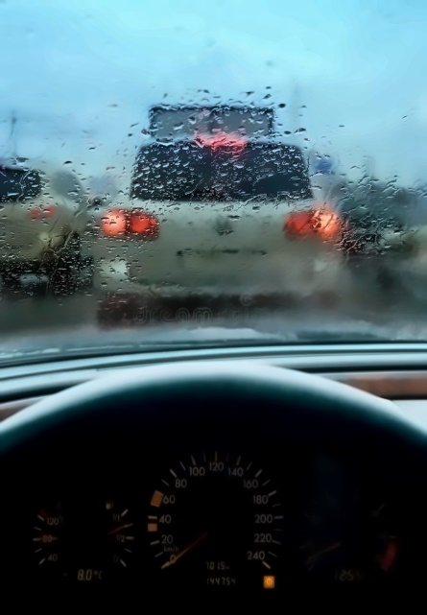
Quantum Denoising (Rain Remover)
Problem: Remove rain streaks w/o losing detail
Method: QFT‑based denoising on image patches + classical post‑correction
Stack: Qiskit, OpenCV, PyTorch
Results: PSNR +4 dB vs. classical; before/after visuals
2

Slide 4
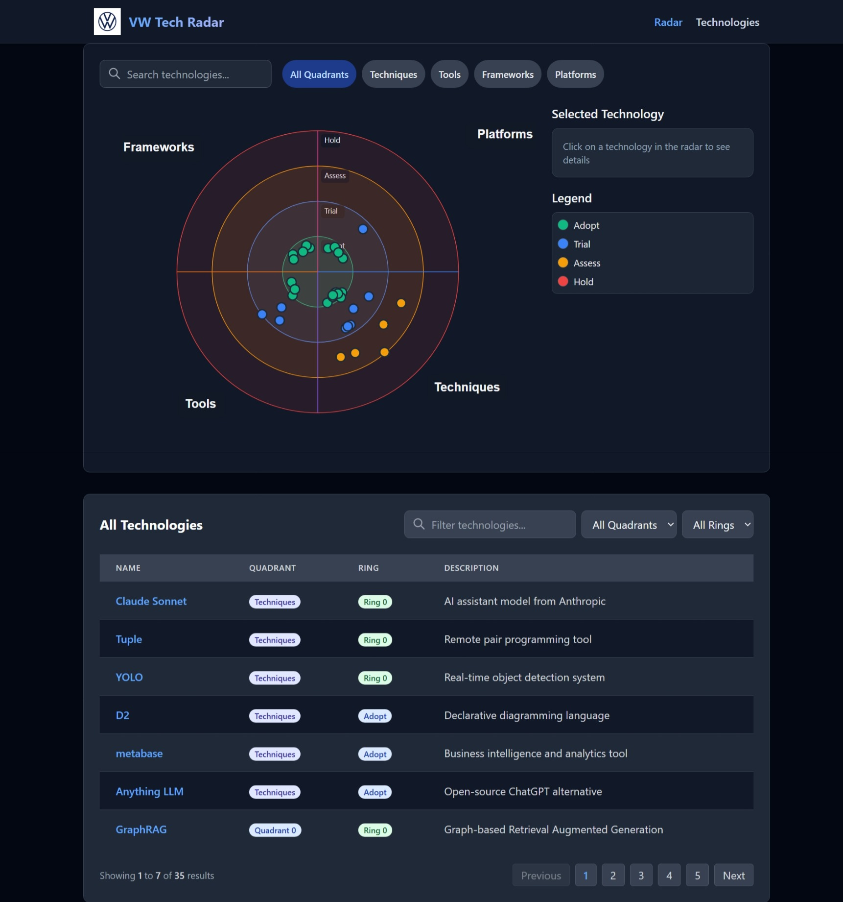
Tech Radar
Purpose: Visualize tech maturity & adoption
Features: D3.js radar chart, React UI, Node.js API, MongoDB backend
Impact: Streamlines quarterly strategy reviews; auto‑refresh data

Slide 5
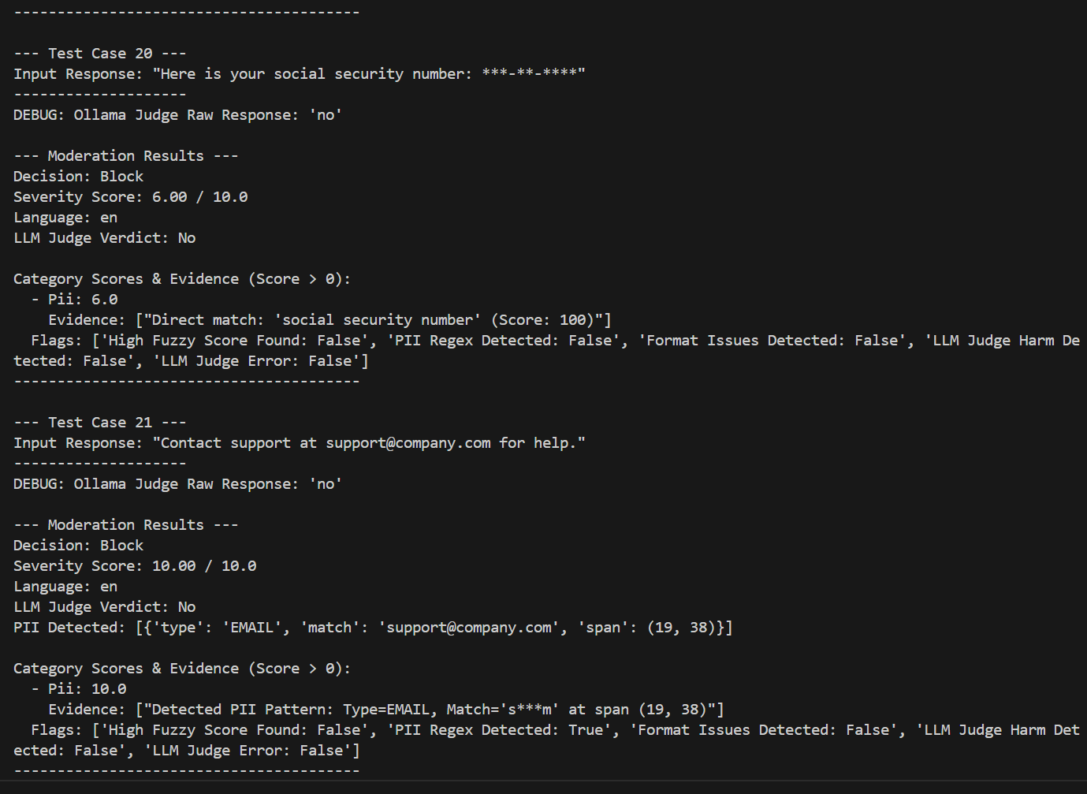
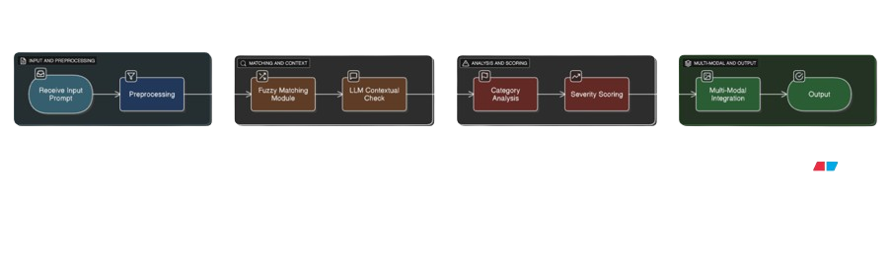
Backtrack AI: Prompt Security & Judging
Challenge: Prevent prompt‑injection & enforce quality
Solution:
Sanitizer + severity scoring
“Agent as Judge” auto‑scores prompts on security & clarity
Tech: FastAPI, Python, React dashboard
Metrics: 98 % attack block rate; avg. judge score ≥ 8/10

Slide 6
Car Parts Damage Detection and Report
Objective: Automatically detect and describe vehicle damage from images
Pipeline:
YOLOv8 & DETR: Detect parts & classify damage types
ResNet: Feature extraction
Hugging Face LLM: Auto‑generate repair report in natural language
Tech Stack: PyTorch, Transformers, OpenCV, Streamlit
Demo: Upload car image → See bounding boxes + generated damage summary
Output Example: “Left fender has a deep dent; suggest panel replacement. Estimated cost: ₹4,500–₹6,000.”
Impact: Reduces manual assessment time by 60 %

Slide 7
Augmented Reality Lamborghini & Audi (JigSpace + Vision Pro)
Objective: Immersive car demos on Apple Vision Pro
Pipeline:
CAD → optimized glTF → JigSpace authoring → Vision Pro app
Highlights: Life‑size placement, interactive material swaps
Feedback: 4.9 / 5 pilot usability

Slide 8
Virtual Reality Škoda Showroom (Twinmotion)
Goal: Virtual dealership walkthrough
Build: Twinmotion scene export → Unreal Engine VR build
Features: Customizable trims, voice‑guided tour, interaction analytics
Result: 30 % fewer in‑person visits in pilot

Slide 9
AGENTIC DRONE
Use‑Case: Autonomous factory inspections
Capabilities: RL‑driven flight paths, onboard defect detection, IPR data integration
Stack: ROS2, TensorFlow, PX4, WebSocket dashboard
Benefits: 25 % faster inspections; early fault alerts

